Slide 1

Module 3
Congestion Control

Slide 2
Approaches towards congestion control
two broad approaches towards congestion control:
end-end congestion control:
no explicit feedback from network
congestion inferred from end-system observed loss, delay
approach taken by TCP
network-assisted congestion control:
routers provide feedback to end systems
single bit indicating congestion (SNA, DECbit, TCP/IP ECN, ATM)
explicit rate for sender to send at

Slide 3
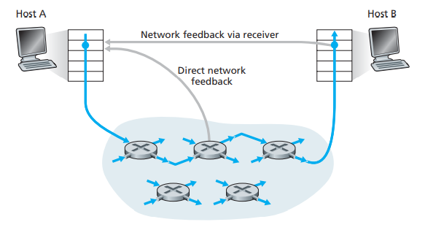
Network Assisted Congestion Control
Direct feedback may be sent from a network router to the sender. This form of notification typically takes the form of a choke packet.
The second form : when a router marks/updates a field in a packet to indicate congestion.
Upon receipt of a marked packet, the receiver then notifies the sender of the congestion indication.
Two feedback pathways for network-indicated congestion information

Slide 4
Case study: ATM ABR congestion control
ABR: available bit rate:
“elastic service”
if sender’s path “underloaded”:
sender should use available bandwidth
if sender’s path congested:
sender throttled to minimum guaranteed rate
RM (resource management) cells:
sent by sender, interspersed with data cells
Each data cell contains an explicit forward congestion indication (EFCI) bit.
bits in RM cell set by switches (“network-assisted”)
NI bit: no increase in rate (mild congestion)
CI bit: congestion indication
RM cells returned to sender by receiver, with bits intact

Slide 5

Case study: ATM ABR congestion control
RM cell
data cell
two-byte ER (explicit rate) field in RM cell
congested switch may lower ER value in cell
Sender’s send rate thus max supportable rate on path
EFCI bit in data cells: set to 1 in congested switch
if data cell preceding RM cell has EFCI set, receiver sets CI bit in returned RM cell

Slide 6
TCP congestion control: additive increase multiplicative decrease
approach: sender increases transmission rate (window size), probing for usable bandwidth, until loss occurs
additive increase: increase cwnd by 1 MSS every RTT until loss detected
multiplicative decrease: cut cwnd in half after loss
additively increase window size …
…. until loss occurs (then cut window in half)
AIMD saw tooth
behavior: probing
for bandwidth
cwnd: TCP sender
congestion window size
time

Slide 7
Congestion Control Introduction
If no congestion : increase the rate
If congestion : reduces the send rate
This approach raises three questions:
how does a TCP sender limit the rate at which it sends traffic into its connection
how does a TCP sender perceive that there is congestion on the path between itself and the destination
what algorithm should the sender use to change its send rate

Slide 8
TCP Congestion Control: details
How does a TCP sender limit the rate at which it sends traffic into its connection
sender sequence number space
TCP sending rate:
roughly: send cwnd bytes, wait RTT for ACKS, then send more bytes
cwnd
last byte
ACKed
last byte sent
sent, not-yet ACKed
(“in-flight”)
rate
cwnd
~
bytes/sec
sender limits transmission:
the amount of unacknowledged data at a sender may not exceed the minimum of cwnd and rwnd
cwnd is dynamic, function of perceived network congestion
~
RTT
LastByteSent-
LastByteAcked
cwnd
<

Slide 9
Congestion details
How a TCP sender perceives that there is congestion on the path between itself and the destination
“loss event” at a TCP sender
occurrence of either a timeout or
the receipt of three duplicate ACKs from the receiver
Loss event is the indication of congestion on the sender-to-receiver path
When a loss event doesn’t occur
acknowledgments for previously unacknowledged segments will be received at the TCP sender

Slide 10
Congestion Details
How should a TCP sender determine the rate at which it should send
Three guiding principles:
A lost segment implies congestion, and hence, the TCP sender’s rate should be decreased when a segment is lost
An acknowledged segment indicates that the network is delivering the sender’s segments to the receiver, and hence, the sender’s rate can be increased when an ACK arrives for a previously unacknowledged segment.
Bandwidth probing :
ACKs – increase rate
Loss event – decrease rate

Slide 11
TCP Congestion Control Algorithm
First described in [Jacobson 1988]
Standardized in [RFC 5681].
The algorithm has three major components :
(1) slow start :
value of cwnd begins at 1 MSS and increases by 1 MSS every time a transmitted segment is first acknowledged
(2) congestion avoidance :
value of cwnd equals ssthresh, congestion avoidance mode starts. Tcp increases cwnd more cautiously
(3) fast recovery :
if three duplicate ACKs are detected, in which case TCP performs a fast retransmit

Slide 12
TCP Slow Start
Host A
Host B
when connection begins, increase rate exponentially until first loss event:
initially cwnd = 1 MSS
double cwnd every RTT
done by incrementing cwnd for every ACK received
summary: initial rate is slow but ramps up exponentially fast
Exponential growth ends:
Loss event occurs
Cwnd equals ssthresh, slow start ends and TCP enters congestion avoidance
one segment
RTT
two segments
four segments
time

Slide 13
TCP: detecting, reacting to loss
loss indicated by timeout:
cwnd set to 1 MSS;
window then grows exponentially (as in slow start) to threshold, then grows linearly
loss indicated by 3 duplicate ACKs: TCP RENO
dup ACKs indicate network capable of delivering some segments
cwnd is cut in half window then grows linearly
TCP Tahoe always sets cwnd to 1 (timeout or 3 duplicate acks)

Slide 14
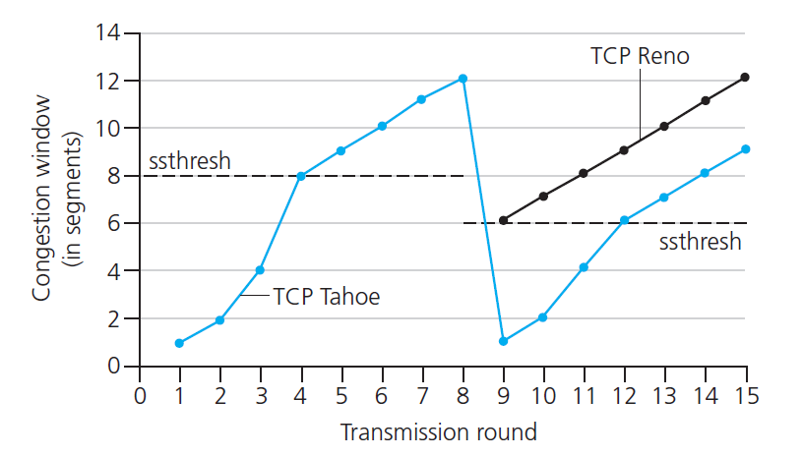
TCP: switching from slow start to CA
Q: when should the exponential increase switch to linear?
A: when cwnd gets to 1/2 of its value before timeout.
Implementation:
variable ssthresh
on loss event, ssthresh is set to 1/2 of cwnd just before loss event

Slide 15


Summary: TCP Congestion Control
New
ACK!
New
ACK!
.
duplicate ACK
new ACK
dupACKcount++
new ACK
cwnd = cwnd + MSS (MSS/cwnd)
dupACKcount = 0
transmit new segment(s), as allowed
cwnd = cwnd+MSS
dupACKcount = 0
transmit new segment(s), as allowed
Λ
cwnd = 1 MSS
ssthresh = 64 KB
dupACKcount = 0
cwnd > ssthresh
slow
start
Λ
congestion
avoidance
timeout
ssthresh = cwnd/2
cwnd = 1 MSS
dupACKcount = 0
retransmit missing segment
duplicate ACK
timeout
dupACKcount++
ssthresh = cwnd/2
cwnd = 1 MSS
dupACKcount = 0
retransmit missing segment
timeout
New
ACK!
ssthresh = cwnd/2
cwnd = 1
dupACKcount = 0
retransmit missing segment
New ACK
dupACKcount == 3
cwnd = ssthresh
dupACKcount = 0
dupACKcount == 3
ssthresh= cwnd/2
cwnd = ssthresh + 3
retransmit missing segment
ssthresh= cwnd/2
cwnd = ssthresh + 3
retransmit missing segment
fast
recovery
duplicate ACK
cwnd = cwnd + MSS
transmit new segment(s), as allowed

